Slide 1
INDIAN E-COMMERCE
Performance Analysis Dashboard
Python | SQL | Power BI Jan 2023 – Dec 2025
1,00,000 orders · 25,000 customers · 9 data tables · 4 dashboard pages

Slide 2
Project Overview
Raw data to business decisions in three steps
1,00,000
25,000
550
36 months
Orders
Customers
Products
Jan 2023 – Dec 2025
1. Python
2. SQL
3. Power BI
Cleaned 9 tables with pandas: checked duplicates, filled missing values, fixed date types.
Answered business questions in MySQL: customers, products, revenue, repeat purchase, campaigns.
Built 4 dashboard pages with DAX measures: Executive Overview, Product & Sales, Customers, Operations.

Slide 3
Data Sources
9 tables, linked through order_id, customer_id, product_id and campaign_id
Table | Rows | What it holds
orders | 1,00,000 | Order date, status, state, amount, channel
order_items | 2,54,331 | Quantity, revenue, cost, profit per item
customers | 25,000 | Segment, loyalty tier, status, signup year
products | 550 | Category, brand, price, cost
shipments | 89,681 | Dispatch, delivery days, delay flag
payments | 1,00,000 | Method, status, amount, refund
customer_reviews | 77,530 | Rating, sentiment
returns | 12,075 | Reason, status, refund amount
marketing_campaigns | 151 | Channel, cost, revenue, ROI

Slide 4
Cleaning and Methodology
What was changed in the data, and how the metrics are defined
Python cleaning
Metric definitions
No duplicate rows found in any table; no rows deleted
Missing review sentiment (233) filled from the rating
Missing age (250) filled with the median of its age group
Missing preferred device (125) set to "Unknown"
Missing product rating (4) filled with the category median
Text dates converted to date type; year, month, day columns added
Revenue and profit: Delivered orders only (₹1.98bn, ₹158.6M)
Margin = profit ÷ item revenue
Churn rate = churned ÷ customers who ever bought (58.9%)
Late delivery = delayed flag on delivered shipments (42.9%)
Return rate = orders with a return ÷ all orders (9.5%)
Customer spend fields include all order statuses

Slide 5
Business at a Glance
Delivered orders, Jan 2023 – Dec 2025
₹1.98bn
₹158.6M
8%
1,00,000
₹24.6K
9.5%
Revenue
Profit
Profit margin
Total orders
Avg order value
Return rate
What this shows
2025 revenue grew 68% over 2024
Orders rose 74% in 2025
Margin stayed steady: 7.8%, 7.9%, 8.2%

Slide 6
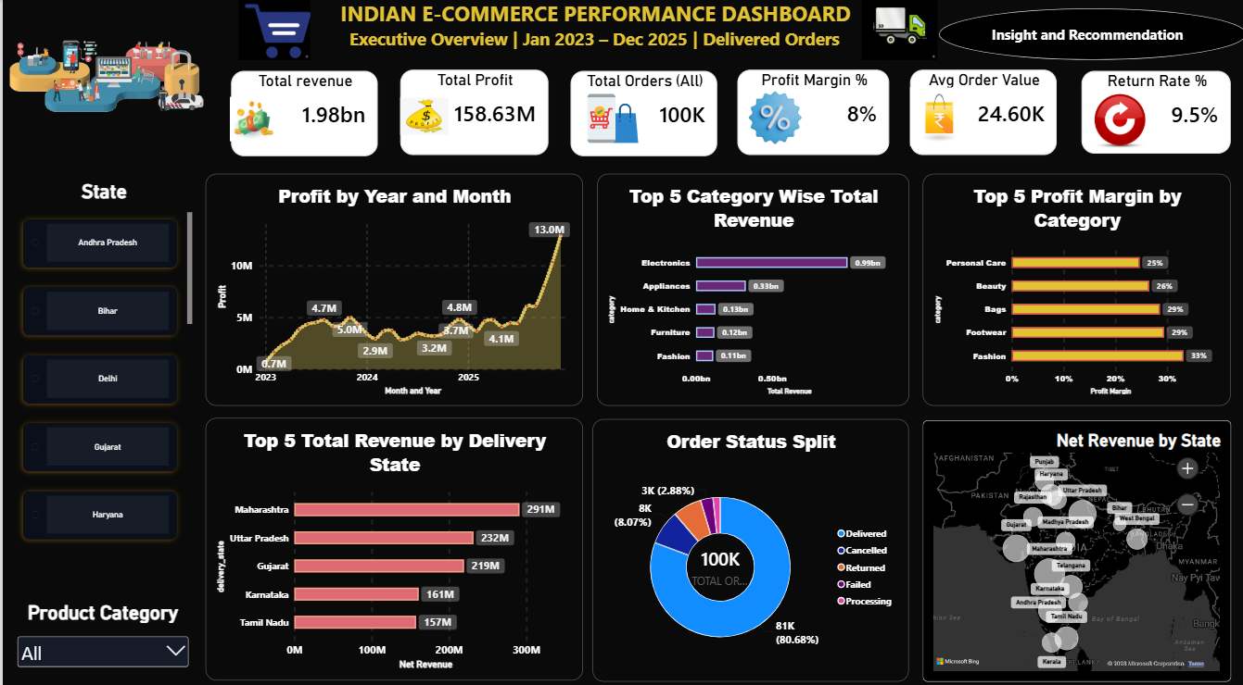
Executive Overview
Power BI dashboard, page 1
₹1.98bn
Revenue, ₹158.6M profit, 8% margin
3.5x
Dec 2025 orders (9.6K) vs Dec 2024 (2.7K)
~50% / 1%
Electronics: share of revenue / profit margin

Slide 7
Executive Overview: Key Insights
What the data shows
Profit Trend: Net profit stood at ₹42.6M in 2023, ₹42.1M in 2024, and surged to ₹73.9M in 2025. Monthly profit peaked at ₹13.0M in December 2025, with Q4 2025 alone contributing ~42% of the total annual profit.
Category Revenue: Electronics generated ₹994M (~50% share) and Appliances generated ₹326M. Combined, they drive ~66% of total revenue.
Top Margins: High-margin categories include Personal Care (25%), Beauty (26%), Bags (29%), Footwear (29%), and Fashion (33%). However, the overall company margin sits at just 8%.
State Revenue Distribution: Maharashtra led with ₹291M, followed by Uttar Pradesh (₹232M) and Gujarat (₹219M). The top 3 states account for 36%, and the top 5 states account for 51% of total revenue across 15 states.
Order Fulfillment Status: 80.7% of orders were successfully delivered. Revenue leakage stands at ~17.7% due to cancellations (8.1%), returns (6.7%), and failed orders (2.9%).
Geographic Concentration: Revenue remains heavily concentrated in high-volume states: Maharashtra, Uttar Pradesh, Gujarat, Karnataka, and Tamil Nadu.

Slide 8
Executive Overview: Recommendations
What to do next
Identify the root drivers behind the Q4 2025 surge (promotional campaigns, festive sales) to proactively forecast inventory and logistics capacity.
Reduce overall dependency on Electronics by renegotiating vendor costs and restructuring product pricing.
Scale marketing spend and inventory allocation for high-margin categories (Fashion, Footwear, Bags, Beauty, and Personal Care).
Strengthen fulfillment infrastructure in the top 5 states while running targeted, lean pilot campaigns in smaller states.
Audit cancellation and failure patterns to minimize the 17.7% non-realized order leakage.

Slide 9
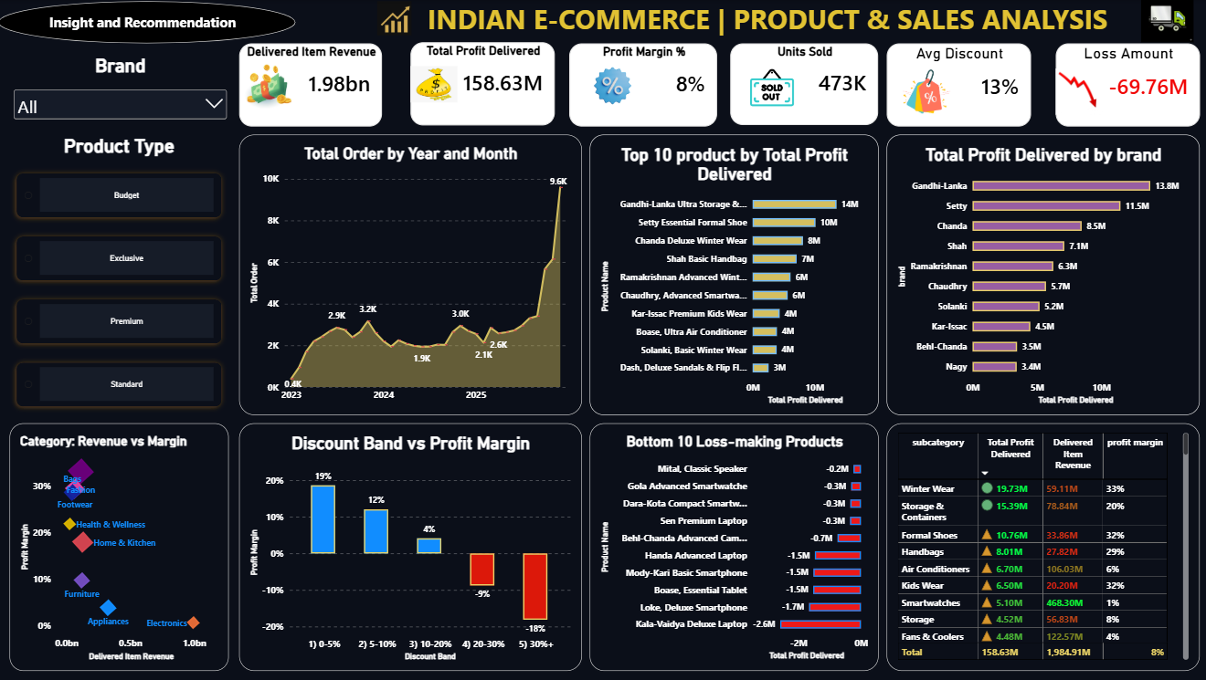
Product & Sales
Power BI dashboard, page 2
-18%
Margin above 30% discount (-9% for 20-30%)
-₹69.8M
Lost on loss-making items
24% / 1%
Smartwatches: share of revenue / margin

Slide 10
Product Deep Dive
The biggest category earns the least
~50%
20%
33%
of revenue is Electronics, at 0.6% margin
is the discount level where margin turns negative
margin in Fashion, the most profitable category

Slide 11
Product & Sales: Key Insights
What the data shows
Order Volume Growth: Average monthly volume hovered between 2K and 3.2K orders throughout 2023–2024. A sharp breakout occurred post-September 2025, reaching 9.6K orders in December 2025 (compared to 2.7K in December 2024).
Top 10 Products: The top 10 SKUs generate ₹65.4M in profit, accounting for 41% of total profitability across 549 products.
Brand Contribution: Gandhi-Lanka led with ₹13.8M, Setty with ₹11.5M, and Chanda with ₹8.5M. The top 3 brands drive 21% of total profit, while the top 10 brands contribute 44% (out of 142 brands).
Category Margin Disparity: Electronics generated ₹994M in revenue at a razor-thin 0.6% margin, contributing only 3.8% of profit. In contrast, Fashion generated ₹113M at a 33% margin.
Discount Elasticity & Erosion: Items discounted between 0–5% maintained a 19% margin. Discounts between 20–30% yielded -9% margin, and discounts exceeding 30% deteriorated to -18% margin. 27% of all items were sold at discounts above 20%, resulting in a ₹46.1M loss, offset by ₹204.7M profit from remaining inventory.
Underperforming SKUs: The "Kala-Vaidya Deluxe Laptop" recorded the largest individual loss (-₹2.6M). Overall, 32 products operate at a loss (totaling -₹11.3M), predominantly within Laptops, Smartphones, and Smartwatches.
Product Line Profitability: Winter Wear (₹19.7M), Storage & Containers (₹15.4M), and Formal Shoes (₹10.8M) were the strongest profit contributors. Smartwatches generated ₹468M in revenue but yielded only ₹5.1M in profit (1.1% margin). Laptops and Smartphones operated at -2.3% and -1.9% margins, respectively.

Slide 12
Product & Sales: Recommendations
What to do next
Align supply chain procurement and operational staffing with anticipated Q4 volume spikes.
Maintain high service levels and safety stock for top 10 SKUs while expanding product development to diversify revenue away from a few key items.
Negotiate improved margins and supplier terms with top brands; eliminate aggressive discounting on low-margin brand portfolios.
Overhaul unit economics for Electronics and Appliances, while shifting merchandising focus toward Fashion and Home & Kitchen.
Cap regular promotional discounts at 20%, restricting deeper cuts strictly to end-of-life clearance sales.
Restructure or delist the 32 loss-making SKUs, or bundle them with high-margin accessories to protect gross margins.
Push marketing investments into Winter Wear, Storage & Containers, and Formal Shoes, while immediately repricing Smartwatches, Laptops, and Smartphones.

Slide 13
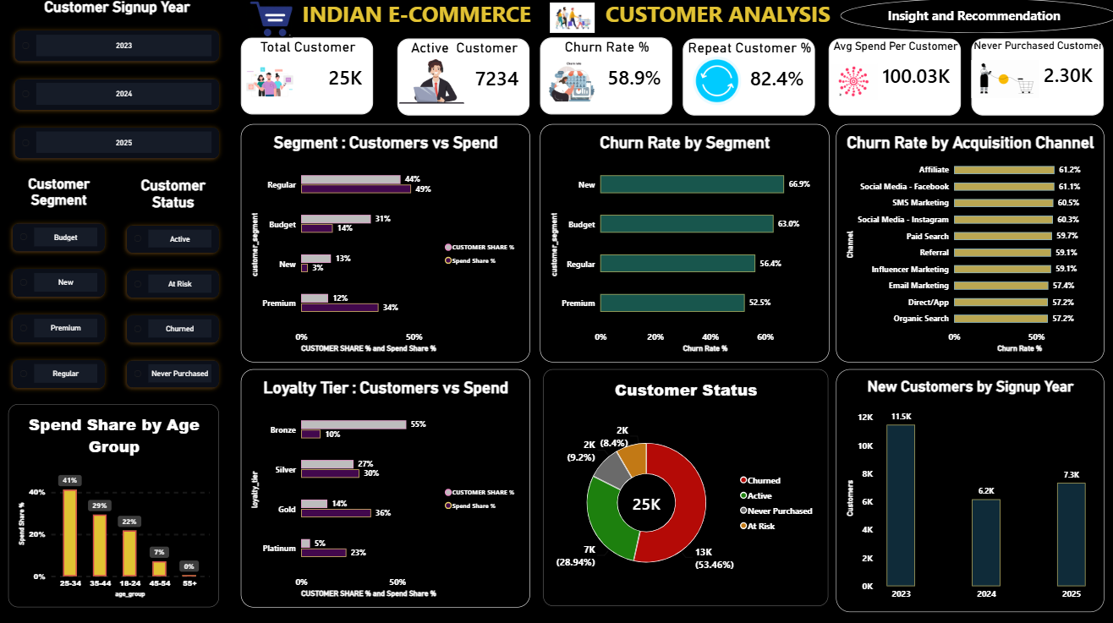
Customers
Power BI dashboard, page 3
58.9%
Churn among buyers (53.5% of all 25,000)
4.5% → 23.5%
Platinum: share of customers → share of spend
11.5K → 6.2K
New signups 2023 → 2024 (7.3K in 2025)

Slide 14
Customer Deep Dive
Few customers bring most of the money, and most of them leave
18% → 60%
66.9%
57–61%
Platinum + Gold customers → share of spend
churn in the New segment (Premium 52.5%)
churn in every channel, so it is not one channel

Slide 15
Customers: Key Insights
What the data shows
Segment Contribution: Premium customers represent 12% of the base but generate 34% of total spend. Budget customers make up 31% of the base but contribute only 14% of spend. New customers account for 13% of the base and 3% of spend.
Segment Churn: New users exhibited 66.9% churn, Budget 63.0%, Regular 56.4%, and Premium 52.5%, indicating that over half of high-value customers also lapse.
Acquisition Channel Churn: Churn rates range narrowly from 57.2% (Organic Search, Direct/App) to 61.2% (Affiliate). The marginal 4% variance indicates churn is systemic rather than channel-specific.
Loyalty Tiers: Platinum members represent 4.5% of users but account for 23.5% of spend. Gold represents 13.6% of users and 36.3% of spend. Bronze comprises 54.6% of users but only 10.1% of total spend.
Customer Lifecycle Distribution (25,000 Total): Churned: 13,365 (53.5%), Active: 7,234 (28.9%), Never Purchased: 2,300 (9.2%), and At Risk: 2,101 (8.4%).
Signup Trends: User signups stood at 11,479 in 2023, fell 46% to 6,177 in 2024, and rebounded by 19% to 7,344 in 2025.
Demographics: The 25–34 age bracket accounts for 41% of spend, followed by 35–44 at 29%, and 18–24 at 22%. Users aged 45+ represent ~8% of spend.

Slide 16
Customers: Recommendations
What to do next
Introduce dedicated tier benefits for Premium and Regular cohorts, with targeted second-order incentives for Budget and New cohorts.
Build an onboarding journey (welcome discount, post-purchase touchpoints) to activate first-time signups.
Deploy an omnichannel customer retention program across the entire base rather than shifting acquisition channels.
Provide Gold and Platinum tiers with priority customer support and early product access, while targeting Silver members with tier-upgrade incentives.
Deploy win-back offers to the 2,101 At Risk users, design reactivation workflows for the 13,365 Churned users, and send first-order conversion coupons to the 2,300 Never Purchased accounts.
Conduct a root-cause analysis on the 2024 signup decline (budget vs. acquisition channels) to sustain the 2025 recovery trajectory.
Focus main commercial acquisition efforts on the 25–44 age demographic, while testing niche channels and assortments for the 45+ segment.

Slide 17
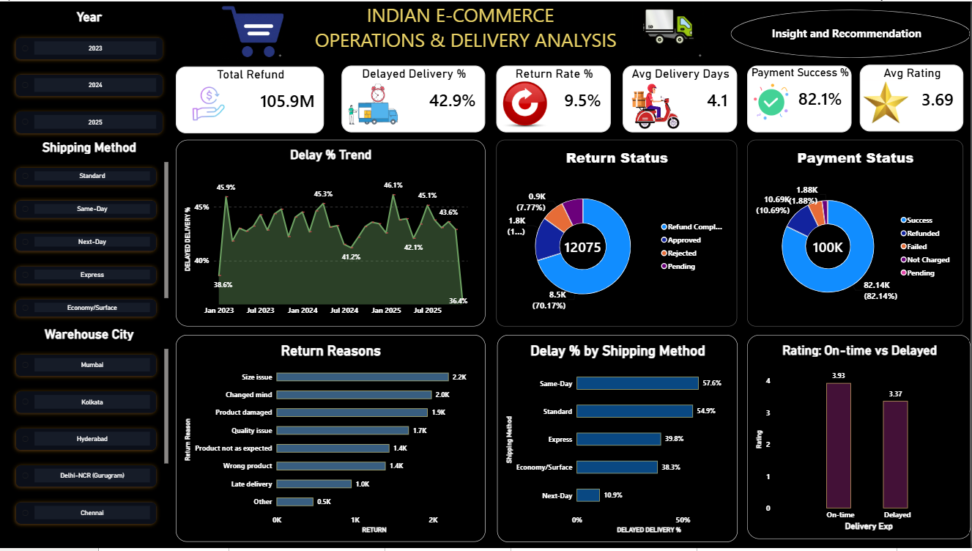
Operations
Power BI dashboard, page 4
42.9%
of deliveries are late
3.93 vs 3.37
Rating: on-time vs late delivery
12,075
returns, ₹105.9M refunded

Slide 18
Operations Deep Dive
Delivery promises are missed, and many returns are avoidable
45%
35.5%
82.1%
of delivered shipments use Standard, and 55% of them are late
of returns: damaged, wrong product or late delivery
payment success, 82–83% for every method

Slide 19
Operations: Key Insights
What the data shows
Delivery Delays: Late deliveries consistently fluctuated between 38.6% and 46.1% without a sustained downward trend. December 2025's dip to 36.4% was an isolated monthly variation rather than a proven operational fix.
Return & Refund Processing: Out of 12,075 returns, 70.2% were refunded. 14.8% were approved awaiting payout, 7.2% remained pending review, and 7.8% were rejected. Approximately 22% (2,664 returns) have pending refund resolutions.
Payment Reliability: Transactions showed 82.1% Success, 10.7% Refunded, 5.1% Failed, and 1.9% Not Charged. The success rate remained uniform (82–83%) across all payment methods.
Return Drivers: Primary reasons include Sizing Issues (2,201), Customer Changed Mind (1,984), and Damaged Products (1,933). Internal fulfillment errors (Damaged + Incorrect Product + Late Delivery) accounted for 4,287 returns (35.5% of total returns).
Delay by Shipping Method: Same-Day shipments experienced 57.6% delays, Standard 54.9%, Express 39.8%, Economy 38.3%, and Next-Day 10.9%. Standard remains the primary shipping method (~45% volume share).
Customer Sentiment Impact: On-time deliveries maintained an average rating of 3.93 versus 3.37 for late deliveries (a 0.56 drop). While correlated, delivery speed is one of multiple contributing factors to low CSAT.

Slide 20
Operations: Recommendations
What to do next
Establish a company-wide SLA to bring delayed shipments below 30%, monitored weekly, and secure buffer fleet capacity for Q4 peak periods.
Expedite settlement for the 2,664 pending and approved refunds, and display clear refund tracking timelines inside the user account portal.
Implement automated retry logic, alternate payment prompts, and drop-off recovery reminders for failed payment sessions.
Improve size charts, measurement guides, and product visuals to curb fit issues; audit warehouse packaging to minimize transit damage; and implement barcode scan verification at packing stations to stop wrong dispatches.
Recalibrate estimated delivery dates (EDDs) shown at checkout for Standard and Same-Day options, renegotiate partner carrier SLAs, and benchmark Standard processes against the Next-Day operational model (10.9% delay).
Trigger automated apologies paired with small discount vouchers for delayed consignments to protect customer satisfaction ratings.

Slide 21
Key Insights
Eight findings from the data
Growth
Concentration
2025 revenue rose 68% with a steady 8% margin
Electronics gives ~50% of revenue at 0.6% margin
Discounts
Loss items
Above 20% discount, every order loses money
₹69.8M lost on loss-making items; Laptops and Smartphones are negative
Customers
Retention
Top 20% of customers give 63% of spend
58.9% of buyers have churned, in every channel alike
Delivery
Impact
42.9% late; Same-Day 57.6%, Standard 54.9%
Late delivery cuts rating from 3.93 to 3.37

Slide 22
Recommendations
What to do next, and what to track
Metric to track
Cap discounts at 20%
Orders above 20% discount lose money. Review every coupon and campaign above that level.
Margin by discount band
Fix Electronics pricing
Half the revenue earns about 1%. Review cost and price for Smartwatches, Laptops, Smartphones.
Electronics margin
Fix Standard and Same-Day
55–58% are late. Set realistic promises and review courier performance.
Late delivery %
Protect top customers
Gold and Platinum give ~60% of spend. Add a retention program and better onboarding for New customers.
Churn rate
Cut avoidable returns
Improve packaging, quality checks, order accuracy and size guides.
Return rate

Slide 23
Limitations and Next Steps
What to keep in mind, and where the project can grow
Limitations
Next steps
Customer spend and order counts come from stored customer fields, which cover all order statuses and differ slightly from the orders table
Churn comes from the dataset's customer status field
Late delivery and low ratings move together, but this does not prove delay is the only cause
Revenue and profit exclude cancelled, failed and returned orders
Rebuild the same dashboards in Tableau
Marketing deep dive: ROI of 151 campaigns by channel
Customer metrics from the orders table, Delivered only
Build a churn prediction model in Python
Forecast monthly orders for 2026

Slide 24
Thank You
Tools: Python (pandas) · MySQL · Power BI · DAX
Questions and feedback are welcome.

